Slide 1

General Chemistry CHE 101
Chemistry: The Study of Change
Chapter 1
Dr. Sultana Bedoura

Slide 2
Marks Distribution
Attendance ………………………… 5 points
Class Performance ………………… 5 points
Quiz (Best 3 out of 5)……………… 30 points
Mid-Term Exam……………………. 25 points
Final Exam………………………….. 35 points
Total 100 points

Slide 3
Class Rules
Bring the following items to every class
Class work copy
Calculator
Text book
No make-up quiz will be taken and no incomplete grade will be given
Make-up Mid will be taken only for considerable reasons and must be informed earlier by e-mail or phone. The terms & patterns of the re-take questions will be different

Slide 4
Outline
Introduction
Study of Chemistry
Classification of matter
States of matter
Physical and chemical properties of matter
Measurement

Slide 5
Chemistry !!!

Slide 6
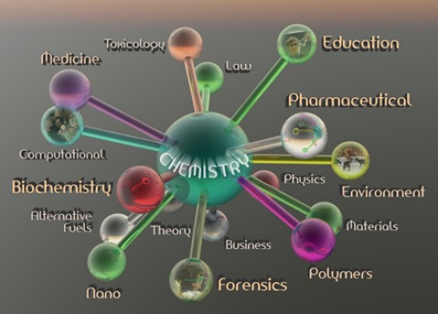
Introduction
Chemistry: the central science

Slide 7
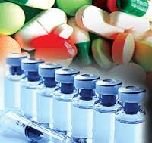
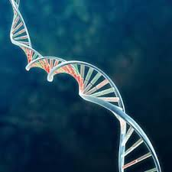
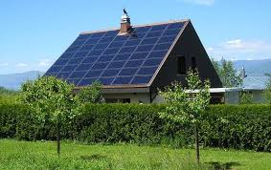
Introduction
Health and Medicine
Sanitation systems
Surgery with anesthesia
Vaccines and antibiotics
Gene therapy
Energy and Environment
Fossil fuels
Solar energy
Nuclear energy

Slide 8
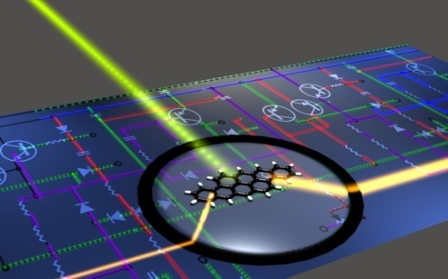
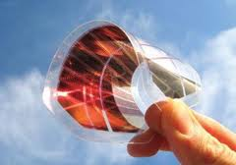
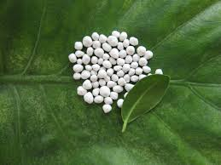
Introduction
Material and Technology
Polymers, ceramics, liquid crystals
Room-temperature superconductors
Molecular computing
Food and Agriculture
Genetically modified crops
“Natural” pesticides
Specialized fertilizers
A good knowledge of the subject will better enable you to appreciate its impact on society and on you as an individual.

Slide 9
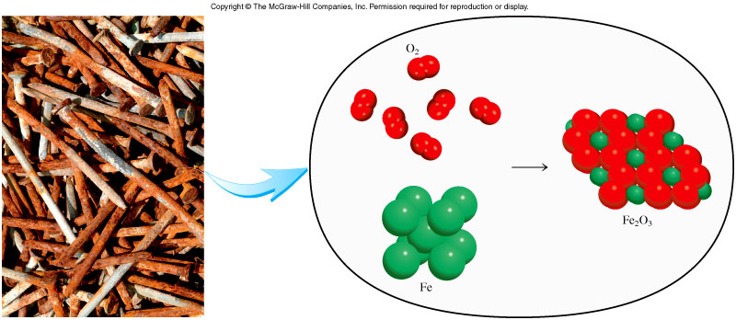
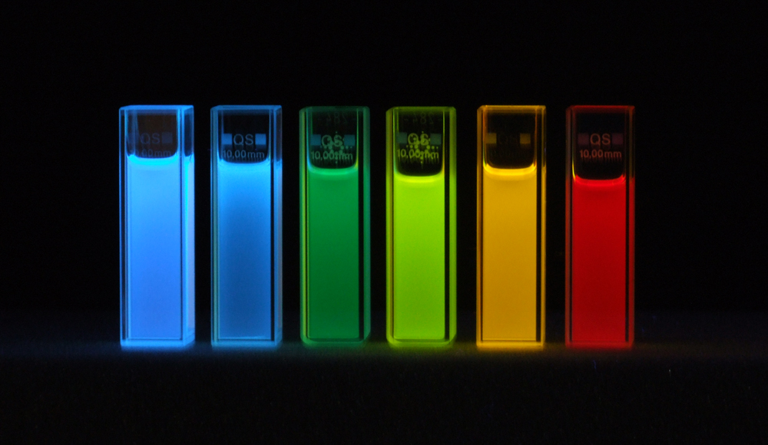
Study of Chemistry
Macroscopic
Microscopic

Slide 10
Chemistry and matter
Chemistry : the study of matter and energy and the interactions between them
Matter : anything that occupies space and has mass
Things that we can see and touch as well as we cannot (air)!

Slide 11
Classification of matter
Matter
Mixture
Homogenous Mixture
Heterogeneous Mixture
Pure Substance
Compounds
Elements
A mixture is a combination of two or more substances in which the substances retain their distinct identities
Physical means can be used to separate a mixture into its pure components.
Example: air, milk, soft drinks, iron filings in sand etc
A substance is a form of matter that has a definite composition and distinct properties
Differ form one another by their composition.
Identified by their taste, appearance- smell etc.
Example: water, NH₃, gold etc

Slide 12
Classification of mixture
Mixtures do not have constant composition
Mixtures are either homogeneous or heterogeneous
Homogeneous mixture: composition of the mixture is the same throughout.
Example: air, milk, sugar-water solution etc
Heterogeneous mixture: composition is not uniform throughout.
Example: cement, iron filings in sand

Slide 13
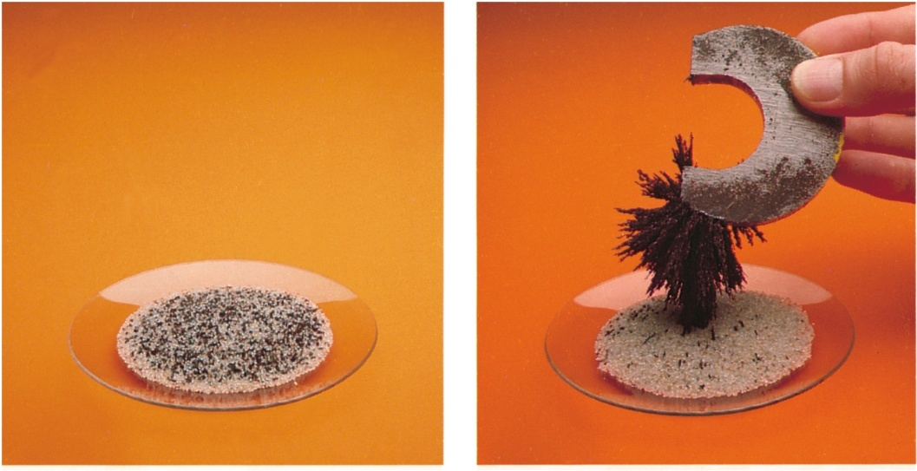
Separation of mixture
Any ( homogeneous/ heterogeneous) mixture can be created and separated by physical means into pure component
Example: sugar and water can be separated from their mixture by distillation.
Magnet can be
used to remove
the iron fillings
from the sand

Slide 14
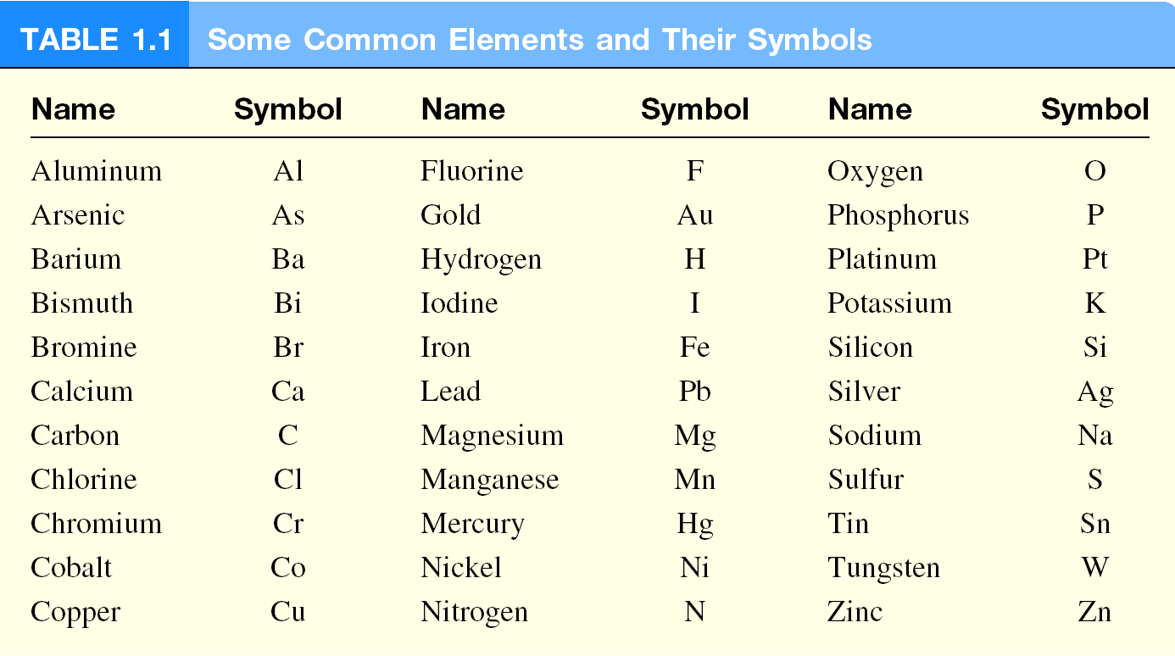
Classification of Substances
Element: a substance that cannot be separated into simpler substances by chemical means
118 elements have been identified
About 98 elements exist naturally on Earth

Slide 15
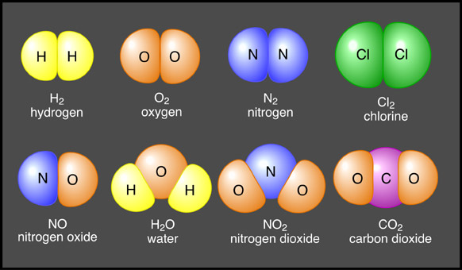
Classification of Substances
Compound : a substance composed of atoms of two or more elements chemically united in fixed proportions.
Compounds can only be separated into their pure components (elements) by chemical means
?
?

Slide 16
Tasks
Classify each of the following as an element, a compound a homogeneous mixture, or a heterogeneous mixture:
seawater heterogeneous mixture
helium gas element
Sodium chloride compound
a bottle of soft drink heterogeneous mixture
milkshake homogeneous mixture
air in a bottle homogeneous mixture
concrete heterogeneous mixture

Slide 17
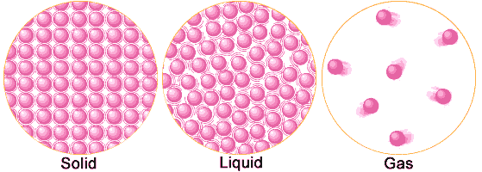
Three states of matter
Particles are essentially
in fixed positions
Holds shape
Particles close
together
Ordered arrangement
Fixed volume
Particles are free to move
Shape of container
Particles close
together
Disorder
Fixed volume
Particles have
complete freedom
Shape of container
Particles far apart
Total disorder
Volume of container

Slide 18
Three states of matter
The three states of matter can be inter-converted without changing the composition of the substance.
Upon heating or by removing the heat states of matter can be changeable .
Melting Point: The temperature at which the transition of a matter from solid state to liquid state occurs.
Boiling Point: The temperature at which the transition of a matter from liquid state to gaseous state occurs.

Slide 19
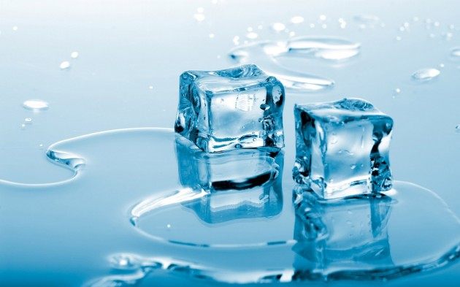
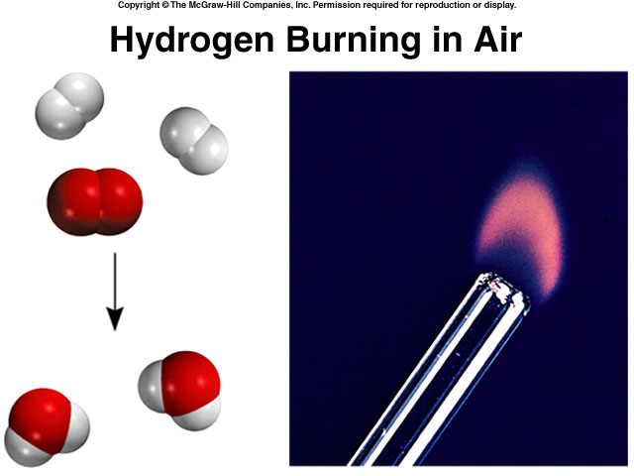
Types of changes
A physical change does not alter the composition or identity of a substance
Examples: Ice melting
A chemical change alters
the composition or identity of the substance(s) involved.
Examples: hydrogen
burns in air to form water

Slide 20
Extensive and Intensive properties
An extensive property of a material depends upon how much matter is being considered
Examples: Mass, weight, length, volume,
An intensive property of a material does not depend upon how much matter is being considered
Examples: density, temperature, colour, odour, boiling point, melting point
Intensive - Properties that do not depend on the amount of the matter present.
Extensive - Properties that do depend on the amount of matter present.

Slide 21
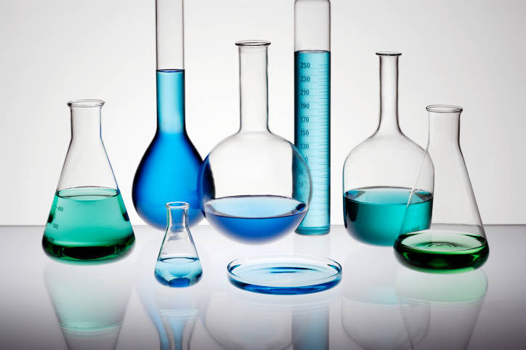
Measurement
Macroscopic Property Measurement:
Length/Scale: meter stick
Volume: Burette, pipette, graduated cylinder, volumetric flask
Mass :balance measures
Temperature: thermometers
Microscopic Property
Measurement:
Indirect method

Slide 22
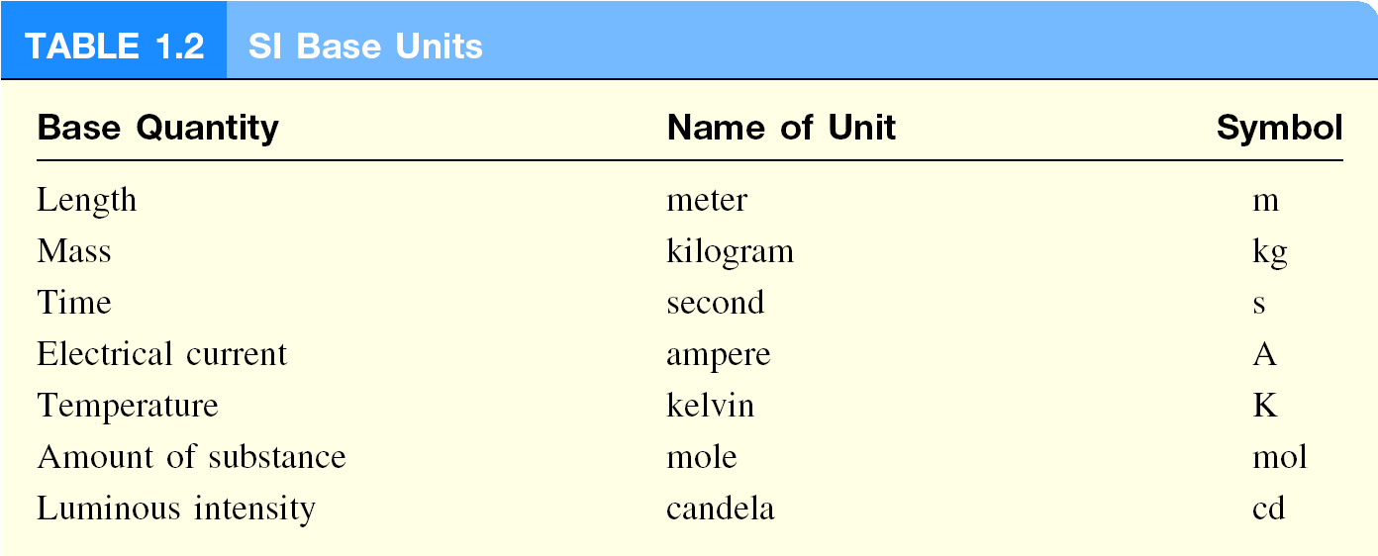
International system of Units (SI)

Slide 23
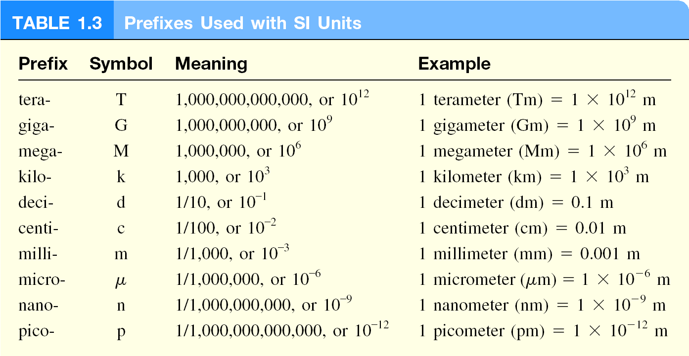

Slide 24
Mass and weight
Mass:
a measure of the total amount matter in an object.
fixed for a specific object
SI unit of mass is the kilogram (kg)
In chemistry,the smaller gram (g) is more convenient:
1 kg = 1000 g = 1 x 10³ g
Weight:
the force that gravity exerts on an object.
not fixed in the universe

Slide 25
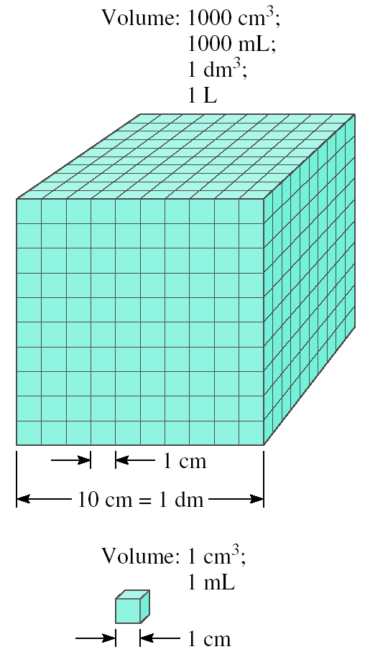
Volume
Volume: is the quantity of three-dimensional space enclosed by some closed boundary.
SI unit: m³ ; as unit for length is Meter(m).
For smaller objects chemist use cm³ and dm³
Liter is also unit for volume of water/ liquid but not SI.
1mL= 1 cm³
= (1 x 10⁻² m)³ = 1 x 10⁻⁶ m³
1L = 1 dm³
= (1 x 10⁻¹ m)³ = 1 x 10⁻³ m³

Slide 26
Density
Density: Mass in per unit volume.
Unit: d= m/v
d= g/cm³ = g/mL = 1000 kg/m³
Problem
The density of mercury, the only metal that is a liquid at room temperature, is 13.6 g/mL. Calculate the mass of 5.50 mL of the liquid.
Ans: 74.8 g

Slide 27
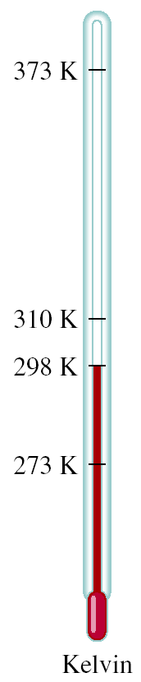
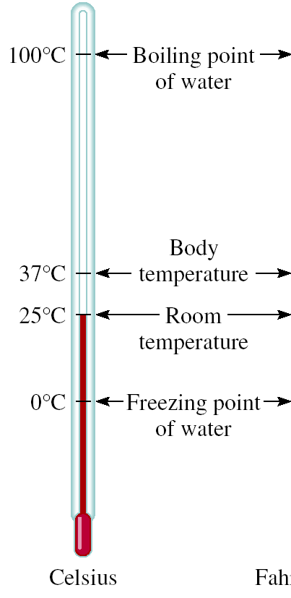
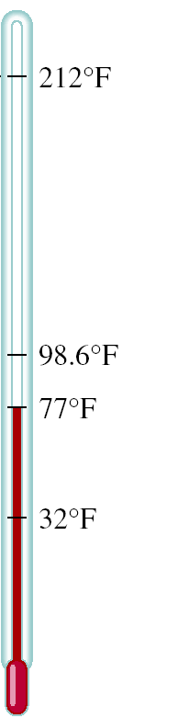

Comparison of temperature scales
K = ⁰C + 273.15
273 K = 0 ⁰C
373 K = 100 ⁰C
9
⁰F = x ⁰C + 32
5
32 ⁰F = 0 ⁰C
212 ⁰F = 100 ⁰C

Slide 28
Convert 172.9 ⁰F to degrees Celsius
9
⁰F = x ⁰C + 32
5
9
⁰F – 32 = x ⁰C
5
5
x (⁰F – 32) = ⁰C
9
5
⁰C = x (⁰F – 32)
9
5
⁰C = x (172.9 – 32) = 78.3
9

Slide 29
Practice Exercise
Convert the following temperature to °Celsius/ °Fahrenheit/Kelvin –
95 ° F→ C
77K → F
Ans: 35 °C , -320.80 °F

Slide 30
Scientific Notations
Chemists often work with numbers which are either extremely large or extremely small.
1 g Hydrogen has
602,200,000, 000, 000, 000, 000, 000 atoms
Mass of Hydrogen atom
0.00000000000000000000000166 g
Working with very large and very small numbers we use a system called Scientific Notation.

Slide 31
Scientific Notations (N x10^{n})
10^{n}
If n=0 then,10⁰ =1
If n=1 then,10¹ =10
If n=2 then,10² =100
If n=3 then,10³ =1000
M x10^{n}
If M=123.45 & n=4
∴ 123.45 x10⁴
= 123.45 x 10000
= 1234500
Now,
Move the point →
123.45 x10⁴
=12345 x10
Move the point ←
123.45 x10⁴
=1.2345 x10
2
6
point moves →; n↓
point moves ←; n ↑
General practice: Take the first non zero number and give a point after that

Slide 32
Scientific Notations (N x10^{n})
10^{-n}
If n=0 then,10⁰ =1
If n=1 then,10⁻¹ =0.1
If n=2 then,10⁻² =0.01
If n=3 then,10⁻³ =0.001
M x10^{-n}
If M=123.45 & n=1
∴ 123.45 x10⁻¹
=123.45 x 0.1
= 12.345
If n=2
∴ 123.45 x10⁻²
= 1.2345
If n=3
∴ 123.45 x10⁻³
= 0.12345
If n=4
∴ 123.45 x10⁻⁴
= 0.012345
∴ 123.45 = 1234.5 x10⁻¹ = 12345 x10⁻²
= 1.2345 x10² = 0.012345 x10⁴

Slide 33
Addition and subtraction
Power should be same for addition and subtraction.
(7.4x10³) + (2.1x 10³) = 9.5x10³
(4.31x10⁴)+(3.9x10³)
=(4.31x10⁴)+(0.39x10⁴)=4.70x10⁴
Or,(4.31x10⁴)+(3.9x10³)
=(43.1 x10³)+ (3.9x10³)=47.0x10³
(2.22x10⁻²)-(4.10x10⁻³)
=(2.22x10⁻²)-(0.41x10⁻²) =1.81x10⁻²
Notes:
To add or subtract using scientific notation, we first write each quantity say N1 and N2 with the same exponent n, Then we combine N1 and N2; the exponent remain same.

Slide 34
Multiplication & division
For multiplication, add the exponents
(8.0x10⁴) x (5.0x10²) = (8.0x5.0) (10 ⁴⁺²)
= 40 x 10⁶
= 4.0 x10⁷
(4.0x10⁻⁵) x(7.0x10³) = (4.0x7.0) (10 ⁻⁵⁺³)
=28 x 10⁻²
=2.8 x 10⁻¹
For division, substract the exponents
(6.9x10⁷ )/(3.0x10⁻⁵ ) = 6.9/3.0 x 10⁷⁻⁽⁻⁵⁾
= 2.3 x 10¹²
Notes:
To multiply numbers expressed in scientific notation, we multiply N2 and N2 in the usual way, but add the exponents together. To divide using scientific notation, we divide N1 and N2 as usual and subtract the exponents.

Slide 35
Scientific Notations (N x10^{n})
602,200,000,000,000,000,000,000
= 602,200,000,000,000,000,000,000 X 10⁰
(n=0; 10⁰=1)
= 602,200,000,000,000,000,000,000
=(602,200,000,000,000,000,000) x1000
=(602,200,000,000,000,000,000) x10³ (10³=1000)
=(602,200)x10³x10³x10³x10³x10³x10³
=(6.022 x10⁵ )x10³ x 10³ x10³ x10³ x10³x10³
= 6.022 x10⁵⁺³⁺³⁺³⁺³⁺³⁺³
= 6.022 x10²³
0.00000000000000000000000166
= 1.66x10
-24

Slide 36
Significant figures
It is often impossible to obtain the exact value of the quantity under investigation
Significant figures: the meaningful digits in a measured or calculated quantity
when significant figures are used, the last digit is understood to be uncertain
Example: Volume measured, V_{m} = 6 mL
uncertainty of measurement for device,V_{un}= 1 mL
So, actual volume, V_{ac}= (6±1) mL
actual volume range 7 ≥ V_{ac} ≥ 5 mL
Here, 6 significant figure which is uncertain by ± 1 mL
Further improved device, more significant figure
V_{ac}=(6.0 ± 0.1) mL ; 6.1 ≥ V_{ac} ≥ 5.9 mL

Slide 37
Guidelines for significant figures
All non-zero numbers are significant
1.234 kg 4 significant figures
Zeros between nonzero digits are significant
6.06 m 3 significant figures
Zeros that do nothing but set the decimal point are not significant
0.08 L & 0.0008 L 1 significant figure for both
If a number is ≥1, then all zeros to the right of the decimal point are significant
2.0 mg 2 significant figures

Slide 38
Guidelines for significant figures
If a number is <1, then only the zeros that are at the end and in the middle of the number are significant
0.00420 g 3 significant figures
For numbers that do not contain decimal points, the trailing zeros (that is, zeros after the last nonzero digit) may or may not be significant.
400cm 1 or 2 or 3 significant figures !!
Can avoid this ambiguity by using the scientific notation.
400 3 significant figures
4.0 x 10² 2 significant figures
4.00x10² 3 significant figures

Slide 39
How many significant figures are in each of the following measurements
32 mL
2 significant figures
3002 g
4 significant figures
0.0320 m³
3 significant figures
3.2 x 10⁴ molecules
2 significant figures
320 kg
2 or 3 significant figures
32.0 kg
3 significant figures
0.00032 g
2 significant figures

Slide 40
Addition or subtraction
The answer cannot have more digits to the right of the decimal point than any of the original numbers.
89.332
+
one significant figure after decimal point
1.1
90.432
round off to 90.4
3.70
two significant figures after decimal point
-2.9133
0.7867
round off to 0.79

Slide 41
Multiplication and division
The number of significant figures in the result is set by the original number that has the smallest number of significant figures
4.51 x 3.6666 = 16.536366
= 16.5
3 sig figs
round to
3 sig figs
6.8 ÷ 112.04 = 0.0606926
= 0.061
2 sig figs
round to
2 sig figs

Slide 42
Exact numbers
Numbers from definitions or numbers of objects are considered to have an infinite number of significant figures
If an object has a mass of 5.0 g, then the mass of nine such objects is
5.0 g x 9 = 45 g =45.0 g
The number 9 is exact and does not determine the number of significant figures.
2 sig figs
2 sig figs

Slide 43
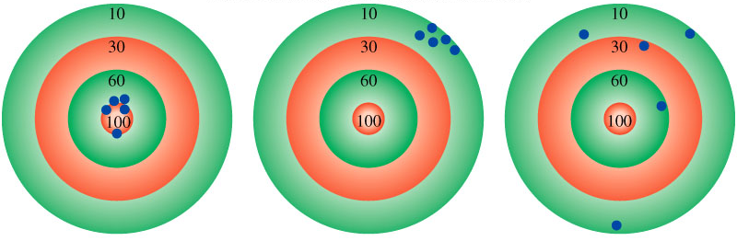
Accuracy and precision
Accuracy : how close a measurement is to the true value
Precision – how close a set of measurements are to each other
accurate
&
precise
precise
but
not accurate
not accurate
&
not precise

Slide 44
Dimensional analysis
Determine which unit conversion factor(s) are needed
Carry units through calculation
If all units cancel except for the desired unit(s), then the problem was solved correctly
given quantity x conversion factor = desired quantity
desired unit
given unit x
= desired unit
given unit

Slide 45
How many mL are in 1.63 L?
Conversion Unit 1 L = 1000 mL
1000 mL
1.63 L x
= 1630 mL
1L
The speed of sound in air is about 343 m/s. What is this speed in miles per hour ?

Slide 46
Thank you
Practice related mathematical problems from Raymond Chang, 10thEd.

